Slide 1
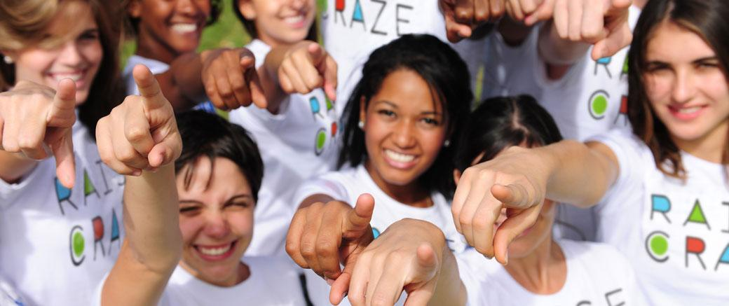
WELCOME TO RAISE CRAZE
LET’S GET READY TO SPREAD SOME KINDNESS!
GOODWATER MONTESSORI
FEBRUARY 2024

Slide 2
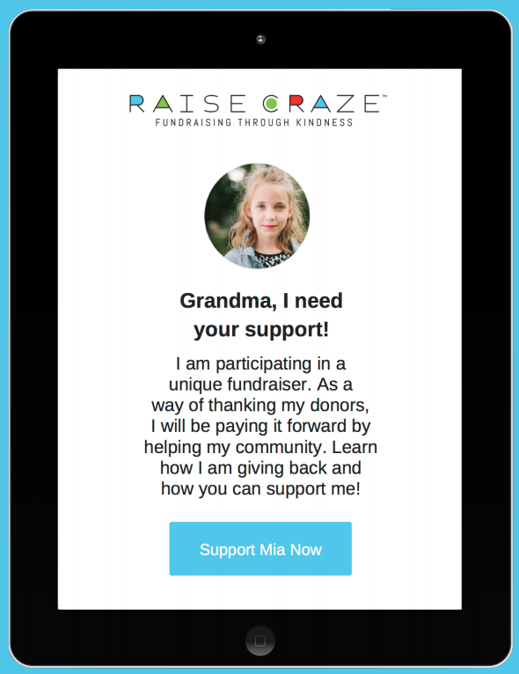
WHAT IS RAISE CRAZE?
Raise Craze is fundraiser centered on good deeds and acts of kindness! We’ll be asking friends and family for donations for our school while performing acts of kindness for others.
Notes:
Let’s give our volunteers a round of applause. That was super impressive!
Again, welcome to our Raise Craze kick-off party! This marks the start of our school’s biggest fundraiser of the year. So what is Raise Craze? Raise Craze is a fundraiser centered on good deeds and acts of kindness! We’ll be asking family and friends for donations for our school while performing acts of kindness for others. By participating in Raise Craze, we will not only be helping our school, but we will also be helping our ENTIRE community - how cool is that? And guess what?

Slide 3

YAY! EVERYONE
CAN PARTICIPATE!
Raise Craze is different from other fundraisers because everyone can participate by completing Acts of Kindness! And every good deed counts...big or small!
Now let’s take a sneak peak to see what Raise Craze is all about!
Notes:
Raise Craze is different from other fundraisers because everyone can participate by completing Acts of Kindness! And every good deed counts...big or small! Now let’s take a sneak peak to see what Raise Craze is all about! (Play Service Reel - next slide)

Slide 4

Notes:
Service Reel

Slide 5
SCHOOL-WIDE
ACTS OF KINDNESS
♥︎ School-Wide AOK
♥︎ #1 Kindness Art
♥︎ #2 Goodwater Orchard Workday
♥︎ #3 Helping Friends
Let’s Serve
Together!
Notes:
So you’re probably wondering why our school does a big fundraiser every year? It’s simple...to make our already awesome school, even more awesome-er. No joking! Improving our school and making it better year after year costs money. If we all work together, we should be able to reach our goals! This year, we’re raising money for: 1, 2, and 3. Sounds pretty amazing right?!?

Slide 6
COMMUNITY
ACTS OF KINDNESS
♥︎ All 15 communities will do an Act of Kindness
Few examples are:
♥︎ Cards and Cookies for the Fire fighters
♥︎ Starting a Earth Club
♥︎ Making Art Murals for our school
Let’s Serve
Together!
Notes:
So you’re probably wondering why our school does a big fundraiser every year? It’s simple...to make our already awesome school, even more awesome-er. No joking! Improving our school and making it better year after year costs money. If we all work together, we should be able to reach our goals! This year, we’re raising money for: 1, 2, and 3. Sounds pretty amazing right?!?

Slide 7
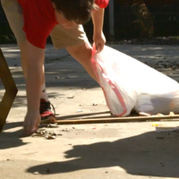
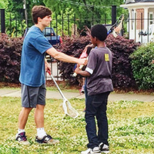
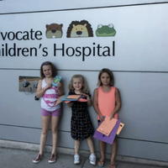
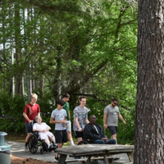
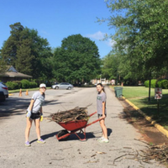
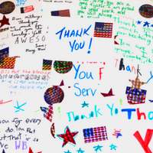
ACTS OF KINDNESS FOR INDIVIDUAL STUDENTS
♥︎ Pick Up Trash
♥︎ Bake for neighbors or family
♥︎ Art for a Nursing Home
♥ Letters for the Fire or Police Department
♥ Endless Possibilities...
Acts of Kindness can be done at home or at school!
Notes:
That was pretty awesome, right? Did you all see how much fun they were having? Helping others makes YOU feel good too! In the video, you saw students picking up trash around their school, helping people carry groceries to their car, spending time at a nursing home, the possibilities are endless and no act of kindness is too small! Let’s talk about some different ways we can serve others. How can you help in your home? Around your neighborhood? In our school? (ASK FOR STUDENT VOLUNTEERS TO ANSWER) Looks like we have some pretty kind students at our school - those are some amazing ideas!

Slide 8
WHY ARE WE
RAISING MONEY?
♥ General Fund: Staff Compensation, Retention & Training
♥ General Fund: Classroom Materials
♥︎ Goodwater’s General Fund - charters receive $1278 per student less than ISDs
Notes:
Explain the general fund: and explain
So you’re probably wondering why our school does a big fundraiser every year? It’s simple...to make our already awesome school, even more awesome-er. No joking! Improving our school and making it better year after year costs money. If we all work together, we should be able to reach our goals! This year, we’re raising money for: 1, 2, and 3. Sounds pretty amazing right?!?

Slide 9

LET’S GET STARTED!
Notes:
Now let’s find out how we all get started! (Show Video)
That looked pretty easy, don’t you think? Instructions will be sent home with you today so you can show your parents how to help sign you up!

Slide 10
Fundraising Goals
Goal #1 - $5,000 Crazy Sock or Hair Day - TBD when hit Goal #1
Goal #2 - $10,000 PJ Day TBD when hit Goal #2
Goal #3 - $15,000 Silly String Ms. Rachel/Ms.Sharmayne/Ms. Kristi TBD when hit Goal #3
Goal #4 - $20,000 Movie and Popcorn Party TBD when hit Goal #3
Goal #5- $25,000 EPIC Dance Party, TBD whenhot Goal #5
Goal #6 - $30,000 Slime Ms. Beverly & Dr. Bruce March 14, Weather Permitting
Notes:
At the end of our fundraiser, we’ll have a Closing Celebration to celebrate all of the Acts of Kindness we completed as well as the money we raised! We’ll also out give awards to two students per grade: one for most completed Acts of Kindness and the other for the most money raised. The top two classrooms for completed AOK and money raised will also win ___. Last but not least, if we meet our school-wide goals for AOK and money raised, we’ll ____. Very exciting! Together we can do this!

Slide 11

TOGETHER, WE CAN
CHANGE THE WORLD!
Thank You & Good Luck!
Notes:
Thank you for coming and we’ll see you in a couple of weeks at our Closing Celebration. Together, we can change the world!

